Slide 1
AI-Powered Interview Preparation Portal with Code Execution Feature

Slide 2

CONTENTS
ABSTRACT
INTRODUCTION
LITERATURE SURVEY
ALGORITHMS
OBJECTIVE
EXISTING & PROPOSED SYSTEM
ARCHITECTURE
FLOW CHARTS
RESULTS/ ACCURACY ENHANCEMENTS
CONCLUSION & FUTURE SCOPE
REFERENCES

Slide 3
ABSTRACT
The increasing demand for efficient and personalized interview preparation solutions has driven the development of AI-based learning platforms. This project presents an AI-Powered Interview Preparation Portal integrated with a real-time code execution feature using the JDoodle API. The system is developed using Spring Boot for backend services, MySQL for data management, and HTML and CSS for the frontend interface. The portal offers functionalities such as user registration, login authentication, curated technical questions, AI-driven personalized preparation paths, and real-time code compilation and execution. By leveraging the JDoodle API, the platform supports execution in multiple programming languages, providing users with instant feedback and enhancing their coding skills. The system architecture is modular, ensuring scalability, security, and high performance. Extensive testing demonstrates the portal’s effectiveness in improving user engagement and preparation quality. The integration of AI technologies and external code execution services like JDoodle offers an innovative approach to interview training, addressing the limitations of traditional preparation methods.

Slide 4
INTRODUCTION
In today’s highly competitive environment, preparing for technical interviews requires not only theoretical knowledge but also hands-on coding practice and personalized guidance. Traditional preparation methods, including books and static question banks, often fail to adapt to the dynamic nature of technical interviews. To address these challenges, the proposed system introduces an AI-Powered Interview Preparation Portal equipped with a real-time code execution feature.This portal is developed using Spring Boot as the backend framework, MySQL as the database management system, and HTML and CSS for creating an intuitive and responsive frontend interface. One of the core features of the portal is real-time code execution, enabled through integration with the JDoodle API, which supports multiple programming languages and offers instant feedback.
The platform offers a range of functionalities, including secure user registration and authentication, curated technical questions categorized by topics and difficulty levels, AI-generated personalized preparation paths, and real-time coding practice environments. The AI module analyzes user performance and suggests improvements, helping candidates systematically improve their technical skills.By combining modern web development frameworks with powerful third-party APIs like JDoodle, this portal provides an efficient, scalable, and user-friendly solution for students, job seekers, and professionals preparing for technical interviews. The project aims to enhance the effectiveness of interview preparation by offering an interactive learning experience that bridges the gap between theoretical knowledge and practical coding skills.

Slide 5
LITERATURE SURVEY
Pelau et al. [1] explored the human-likeness of AI devices in the service industry, highlighting how interaction quality, empathy, and perceived psychological anthropomorphism significantly influence users’ acceptance of AI. Their findings emphasize the need for emotionally intelligent AI interfaces to enhance user engagement and trust.
In the educational domain, Dibitonto et al. [2] presented the design and deployment of LiSA, a campus-based chatbot aimed at assisting students in managing their university activities. The study focused on the human-computer interaction aspects and underscored the importance of user-centric design in creating effective virtual assistants for academic settings.
Addressing tourism, Arteaga et al. [3] proposed an architectural design for a chatbot-based information system recommending tourist sites in Manta, Ecuador. Their research demonstrates the effectiveness of chatbots in location-based service recommendations and the integration of user preferences to tailor suggestions.

Slide 6
Falalta-Séchet et al. [4] introduced Owlie, a chatbot developed to provide emotional support for individuals facing psychological difficulties. The study revealed how emotionally supportive chatbots could offer accessible mental health assistance, especially when conventional therapy is not immediately available.
Finally, Adiwardana et al. [5] examined the development of an open-domain chatbot aimed at mimicking human-like conversations. The research focused on the challenges and advancements in natural language understanding and generation, making significant contributions toward creating more conversationally natural AI systems.

Slide 7
ALGORITHMS
1. User Registration Algorithm
Start
Display the registration form.
User enters name, email, password.
Validate the user input.
Save the user details to the database.
Redirect user to the login page.
End
2. User Login Algorithm
Start
Display the login form.
User enters email and password.
Authenticate credentials.
If login successful:
Redirect to the dashboard.

Slide 8
ALGORITHMS
3.View Interview Questions Algorithm
Start
User selects a category.
Fetch all questions based on the selected category from the database.
Display the list of questions.
End
4.Code Submission and Execution Algorithm
Start
User writes code in the code editor.
User submits the code.
Prepare API request with code details.
Send the request to JDoodle API.
Receive output or error message.
Save code, output, and user info into the database.
Display output to the user.

Slide 9
OBJECTIVE
The objective of this project is to build an interactive, AI-powered Interview Preparation Portal that enables users—especially students and job seekers—to practice and improve their coding skills in a real-world environment.In traditional learning methods, students often struggle to get instant feedback on their coding solutions, and their preparation becomes less effective due to lack of practical testing environments. This project aims to bridge that gap by providing an online code editor integrated with a code execution API (JDoodle) that allows users to write, compile, and execute code directly within the browser.The system also maintains a history of submissions, enabling users to track their learning progress over time. Questions are categorized (e.g., Data Structures, Algorithms), allowing users to focus on specific areas during preparation. Additionally, the platform supports user registration and login, creating a personalized experience where each user can access their dashboard, solve questions, and view their code outputs.By combining code execution, structured question delivery, and submission history, this project offers a self-paced, feedback-driven learning experience aimed at improving a candidate's confidence and coding ability for technical interviews.

Slide 10
EXISTING SYSTEM
Currently, several online platforms such as LeetCode, HackerRank, and GeeksforGeeks provide coding practice environments for interview preparation. These platforms offer a wide range of programming questions, online code editors, and automatic code execution features. While they are effective for users with intermediate to advanced coding skills, they often lack personalized learning paths and detailed submission tracking for beginners. Moreover, many advanced features like mock interviews, company-specific question sets, and performance analytics are locked behind paid subscriptions, limiting full access to all users.
Despite their popularity, existing systems have certain limitations that create challenges for students and freshers who are preparing for interviews. These platforms are primarily designed for competitive programming or large-scale participation rather than personalized academic learning. They usually lack features like user-specific dashboards, detailed tracking of coding history, and academic-level simplicity. As a result, there is a need for a customized solution that offers real-time code execution, easy tracking of submissions, structured question categories, and a user-friendly interface specifically designed for interview preparation and educational purposes.

Slide 11
PROPOSED SYSTEM
The proposed system is an AI-Powered Interview Preparation Portal that allows users to practice coding questions, execute their code in real-time, and track their submissions in a personalized environment. It provides a web-based platform where users can register, log in, select questions by category, and write code directly in an integrated code editor. Upon submission, the system uses an external API (such as JDoodle) to compile and execute the code instantly, returning the output for immediate feedback. This enhances the user’s ability to practice coding in a realistic, interview-like environment.
Additionally, the portal maintains a history of each user's code submissions, including the code, output, and timestamps. This helps users monitor their progress over time and review their previous attempts. Unlike existing platforms, this system focuses specifically on academic and beginner-level users by offering a simple interface, structured question categories, and free access to core features. It is designed to create an efficient, self-paced learning environment that prepares students and job seekers for technical interviews through continuous practice and instant evaluation.

Slide 12
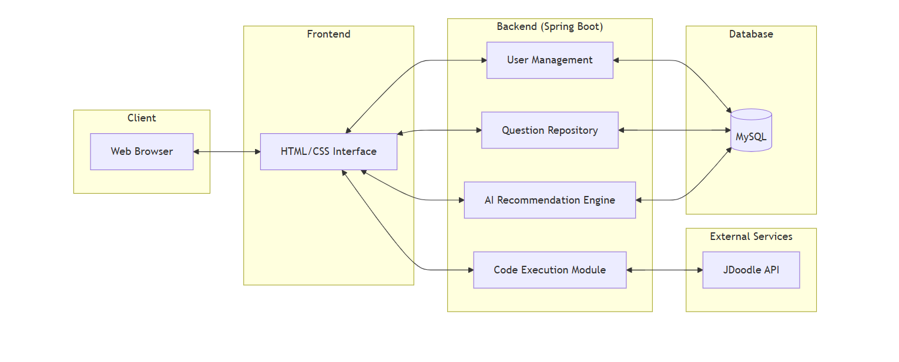
ARCHITECTURE
The architecture of the AI-powered Interview Preparation Portal follows a layered MVC (Model-View-Controller) design using Spring Boot, Thymeleaf, MySQL, and the JDoodle API for code execution. At the top level, users interact with the application through a browser client, which sends requests to various controllers (`AuthController`, `QuestionController`, `CodeController`, and `SubmissionsController`). These controllers handle navigation and core functionalities such as user authentication, question management, code execution, and viewing submission history.
The views are rendered using Thymeleaf templates like `login.html`, `dashboard.html`, `code-editor.html`, and others. Business logic is encapsulated in service classes (`UserService` and `CodeExecutionService`), which coordinate with the repositories (`UserRepository`, `QuestionRepository`, and `SubmissionRepository`) to interact with the database entities (`User`, `Question`, and `Submission`). The system also integrates with the external JDoodle API to compile and execute user-submitted code in real-time, making it a fully functional platform for technical interview preparation.

Slide 13
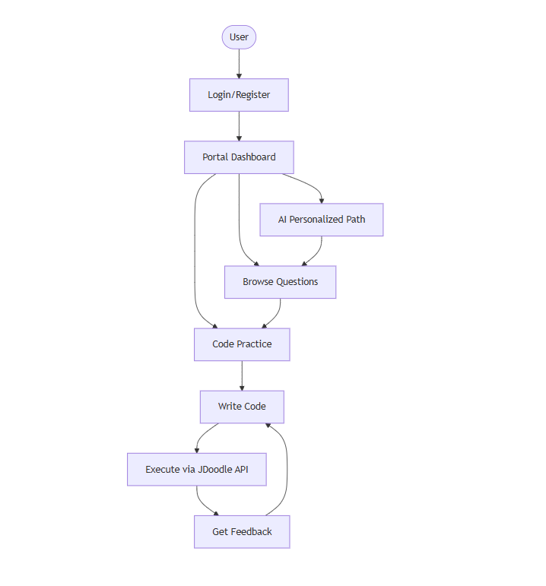
FLOW CHART
The flowchart illustrates the internal architecture of the AI-Powered Interview Preparation Portal, highlighting the interaction between controllers, services, repositories, and entities in a Spring Boot application. Controllers like `AuthController`, `QuestionController`, `CodeController`, and `SubmissionsController` manage user authentication, question display, code execution, and submission history. These controllers interact with service classes such as `UserServiceImpl` and `CodeExecutionServiceImpl`, which implement business logic for user management and external code execution via an API (e.g., JDoodle).
Repositories like `UserRepository`, `QuestionRepository`, and `SubmissionRepository` provide access to the database entities `User`, `Question`, and `Submission`, storing key data such as user credentials, coding questions, and submitted code. The `SecurityConfig` class configures user authentication and authorization, ensuring secure access throughout the application. Together, these components form a modular and well-organized structure that supports real-time code practice, submission tracking, and secure user interaction.

Slide 14
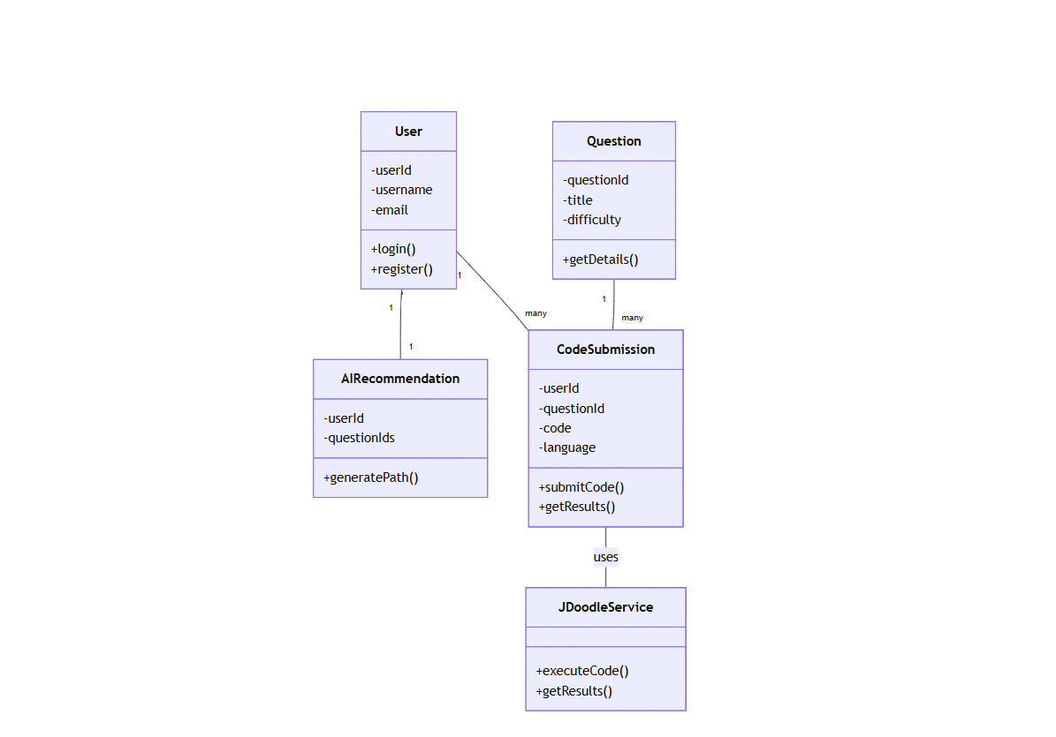
CLASS DIAGRAM
The class diagram represents the structural design of a Spring Boot-based AI Interview Preparation Portal by showcasing the relationships between controllers, services, repositories, and entity classes. The `AuthController` handles user authentication and registration by utilizing the `UserService`, which manages the `User` entity containing attributes like username, password, and email. The `QuestionController` is responsible for displaying questions based on category, using the `QuestionRepository` to access the `Question` entity, which holds question-related data such as category, text, and difficulty. The `CodeController` facilitates code submission and uses the `SubmissionRepository` to store user submissions, represented by the `Submission` entity that includes details like username, submitted question, code, output, and timestamp. The `SubmissionsController` allows users to view their past code submissions by querying `SubmissionRepository` with the username. Each repository is defined as an interface that connects to its respective entity and allows database interaction, while the controllers serve as intermediaries between the user interface and backend logic. This structure follows a clean separation of concerns, improving maintainability and scalability..

Slide 15
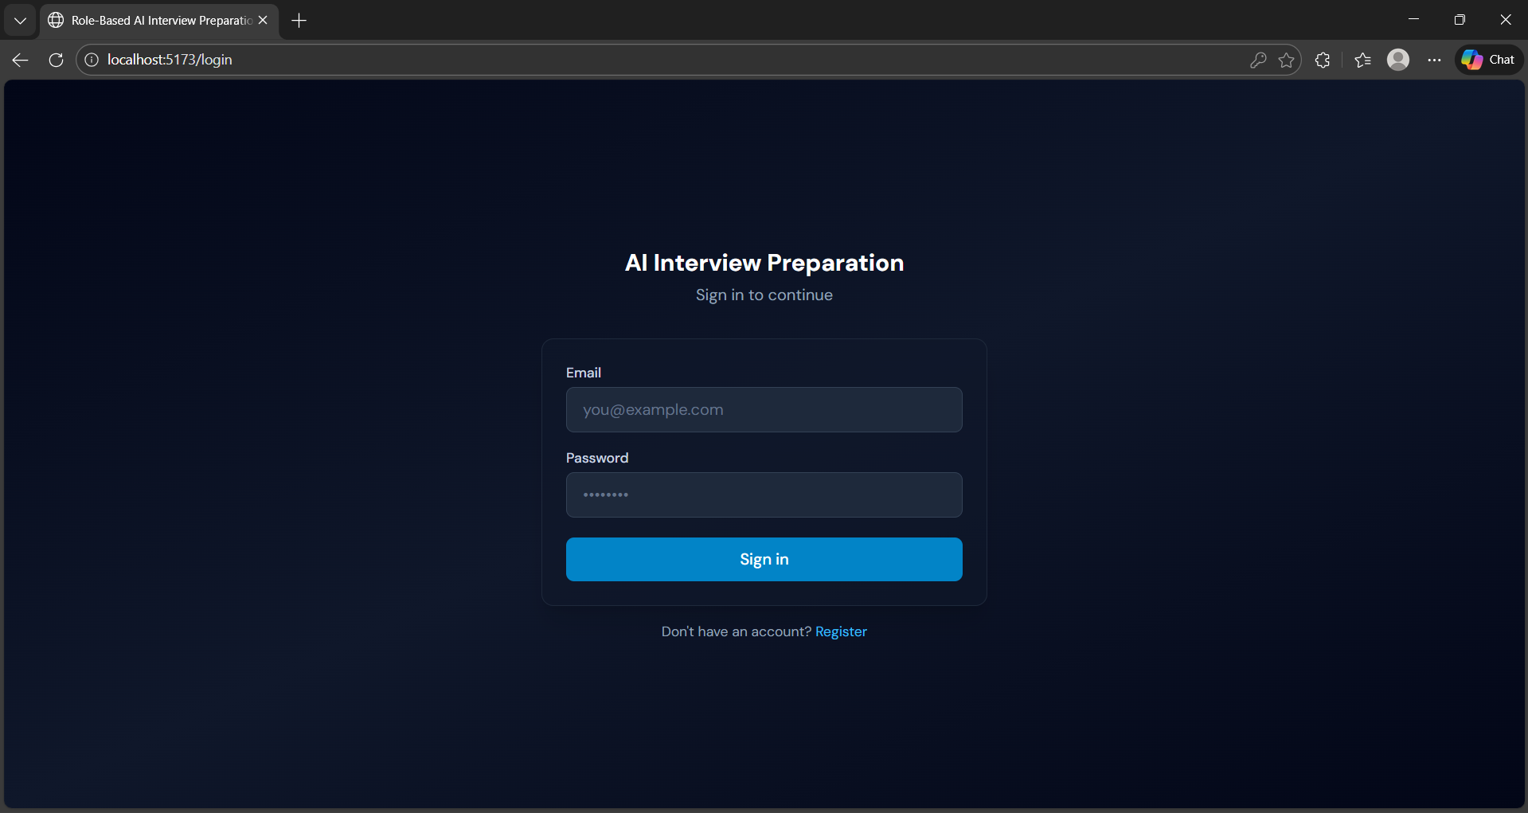
LOGIN PAGE
This page is a login interface for a web application titled AI Interview Preparation. It has a dark-themed design with a centered login form.
Here are the key elements:
Title/Header: "AI Interview Preparation" with the subtitle Sign in to continue.
Form Fields:
Email field (placeholder: you@example.com)
Password field (hidden input with dots/asterisks)
Action Button: A blue "Sign in" button.
Additional Link: Below the form, there’s a prompt "Don't have an account? Register" that directs new users to a registration page.

Slide 16
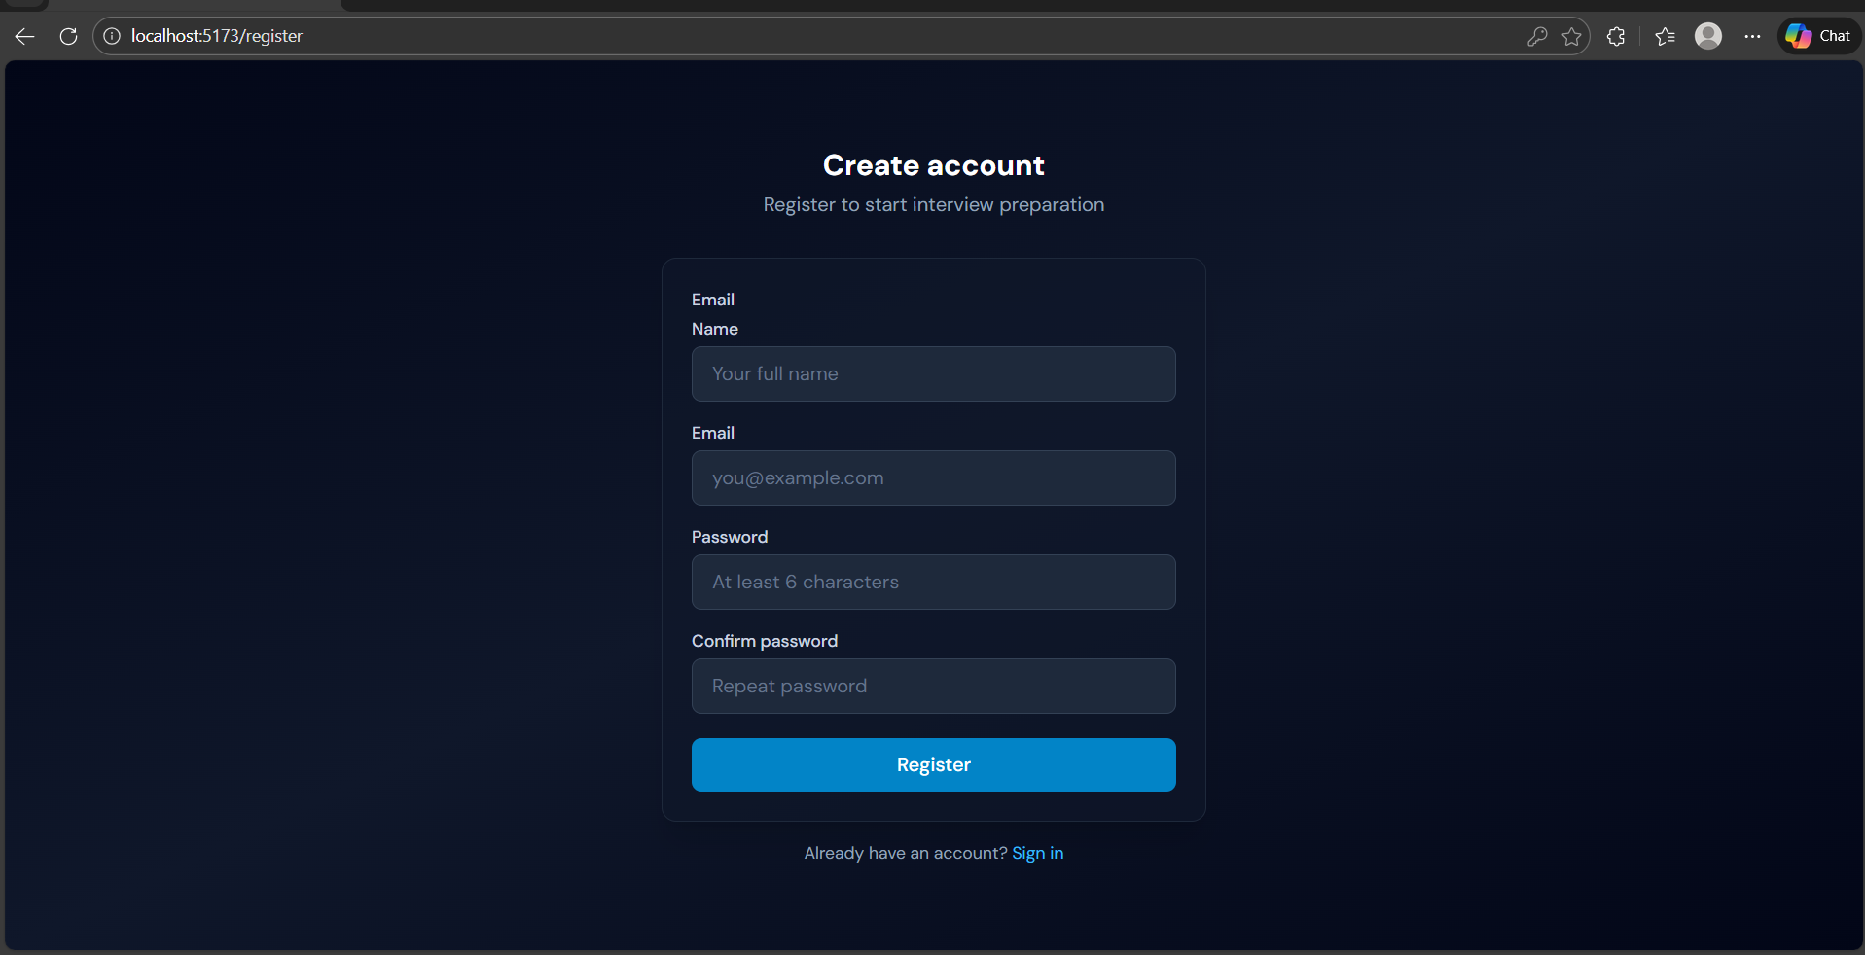
RESULT
The image displays a modern and visually appealing user registration page from a web application. At the center of the screen, a sleek form is overlaid on a tech-themed background. The form includes fields for entering a user's name, email, and password, followed by a prominent green "Register" button. The heading "User Registration" is styled in a vibrant green color, indicating a focus on clarity and user-friendliness. The background showcases a developer’s workspace with a computer screen displaying HTML code, design prototypes, a smartphone, and decorative items like a plant and a coffee cup. This setup suggests that the application is part of a professional or academic web development project, emphasizing both functionality and modern UI design.

Slide 17
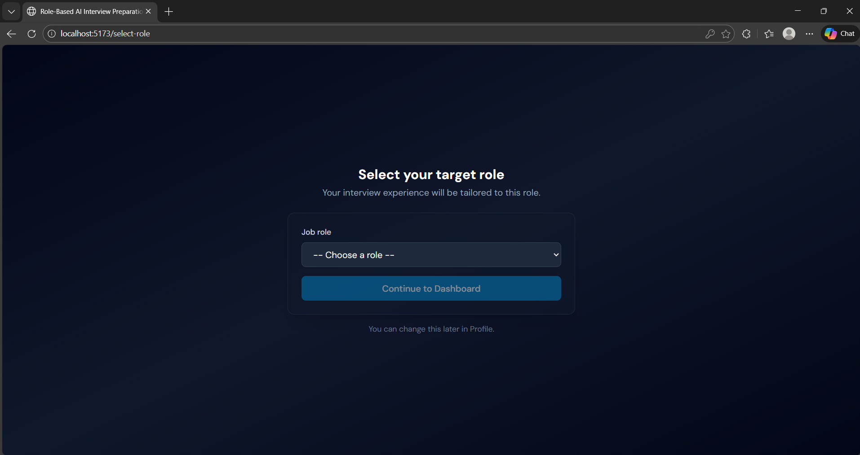
RESULT
Role-Based AI Interview Preparation – Selection Page
Purpose: Lets users choose their target job role to tailor interview practice.
Main Feature: A dropdown menu labeled “Job role” with default option “-- Choose a role --”.
Action Button: Blue button “Continue to Dashboard” to proceed after selection.
Guidance Text: “Your interview experience will be tailored to this role.”
Flexibility: Note at the bottom – “You can change this later in Profile.”

Slide 18
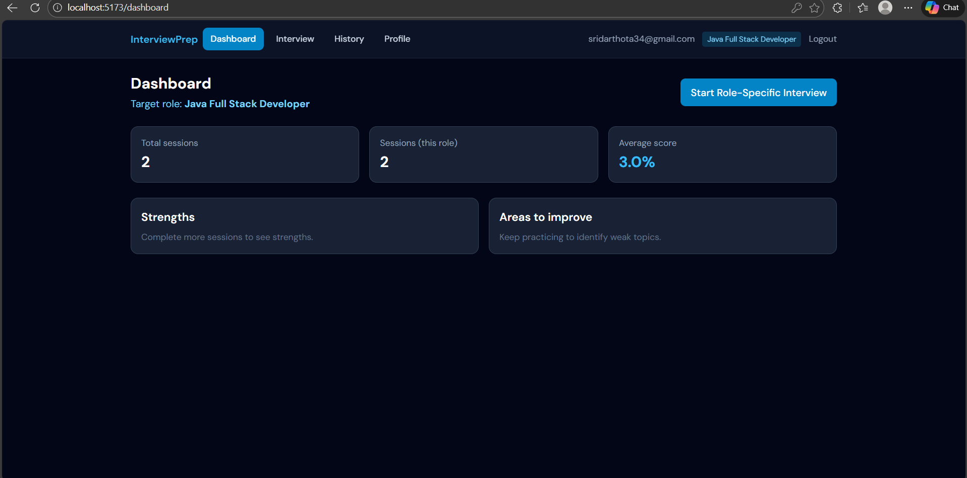
RESULT
The Dashboard provides a quick overview of a user’s interview preparation progress for the selected target role. It displays key metrics such as total interviews completed, role-specific sessions, and the average score.
Users can start a new role-specific interview directly from the dashboard. It also highlights strengths and areas for improvement based on completed sessions.
Overall, the dashboard helps users monitor progress and focus on improving weaker areas efficiently.
Key Features:
Displays selected target role
Shows total and role-specific interview sessions
Displays average interview score
Highlights strengths and improvement areas
Quick access to start new interviews.

Slide 19
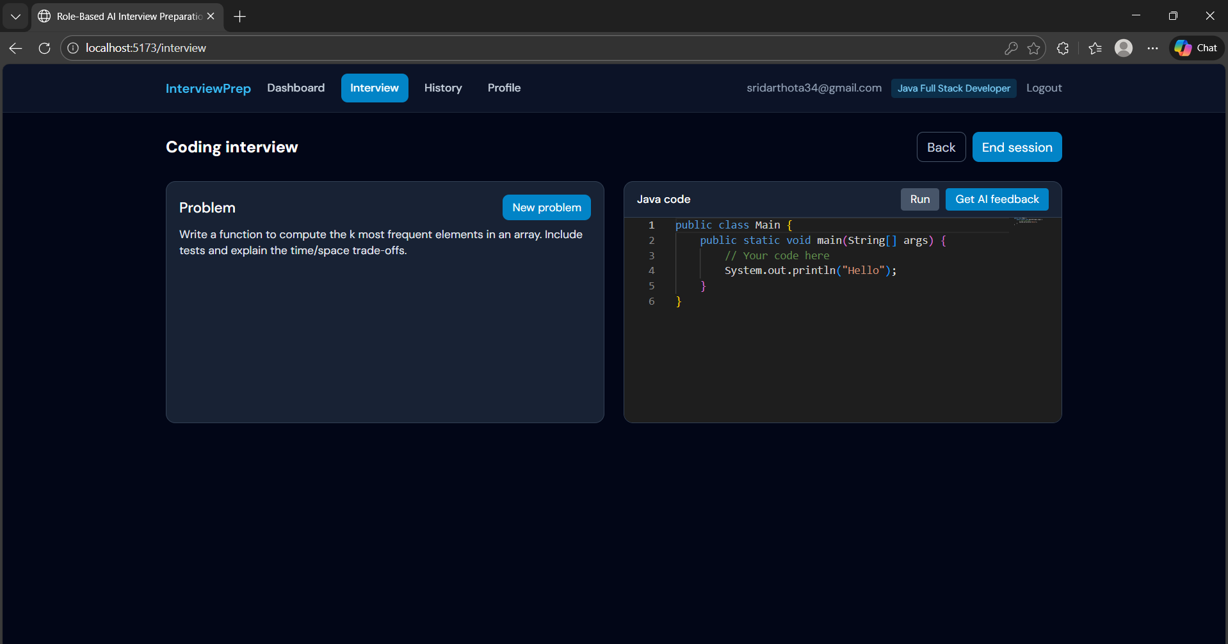
RESULT
Coding Interview Module
Provides an interactive environment for role-based coding interview practice
Displays job-specific coding problems based on the selected target role
Includes an integrated Java code editor for writing and testing solutions
Supports real-time code execution within the platform
Offers AI-based feedback to evaluate logic, correctness, and efficiency
Allows users to load new problems during the same interview session
Provides session controls to navigate back or end the interview safely

Slide 20
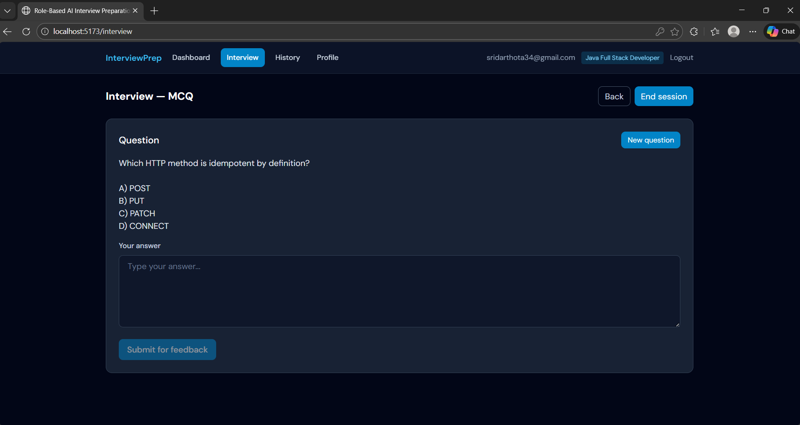
RESULTS
InterviewPrep – MCQ Interview Page
Purpose: Provides interactive multiple‑choice questions for interview practice.
User Context: Logged in as Java Full Stack Developer.
Main Section: Displays a question with four options (e.g., Which HTTP method is idempotent by definition?).
Answer Input: Text box to type an answer, plus a button “Submit for feedback”.
Controls:
Back – Navigate to previous screen
End session – Finish current interview attempt
New question – Generate another practice question
Navigation: Dashboard, Interview, History, and Profile links at the top.

Slide 21
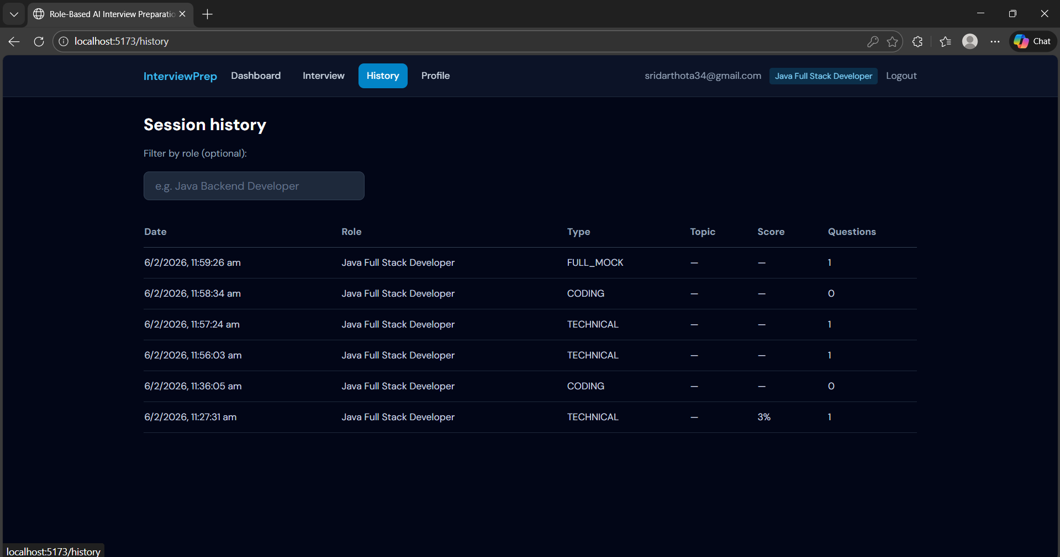
RESULTS
InterviewPrep – Session History Page
Purpose: Displays past interview practice sessions for the user.
User Context: Logged in as Java Full Stack Developer.
Main Section: Session history table with filters for role selection.
Table Columns:
Date – Timestamp of each session
Role – Target job role (Java Full Stack Developer)
Type – Session type (FULL_MOCK, CODING, TECHNICAL)
Topic – Currently blank for most entries
Score – Performance metric (e.g., one entry shows 3%)
Questions – Number of questions attempted (0–1)
Navigation: Links to Dashboard, Interview, History, and Profile.

Slide 22
CONCLUSION
The AI-Powered Interview Preparation Portal with Code Execution Feature provides a practical and user-friendly solution for students and aspiring professionals to improve their coding skills and prepare for technical interviews. By integrating real-time code execution, categorized questions, and personal submission tracking, the system creates a complete learning environment that bridges the gap between theoretical knowledge and practical application.This project not only enhances problem-solving abilities but also offers a structured, self-paced platform for continuous learning. Its simple design, academic focus, and ability to provide instant feedback make it a valuable tool for interview readiness, especially for beginners and educational institutions. Overall, the system fulfills its objective of creating a smart, scalable, and accessible solution for technical interview preparation.

Slide 23
FUTURE SCOPE
The platform will provide a structured question bank, allowing users to filter questions based on difficulty level or category. To further enhance learning, the portal will display a performance dashboard that tracks progress over time, offering graphical representations of solved problems, time spent, and success rates. The admin panel will enable administrators to manage users, questions, and monitor system performance. With an intuitive, responsive user interface designed for beginners, the portal will be optimized for both desktop and mobile use. Over time, additional features like gamification, live coding challenges, and integration with job boards may be added to motivate users and help them transition from practice to real-world job opportunities.

Slide 24
REFERENCES
Pelau, C.; Dabija, D.C.; Ene, I. What Makes an AI Device Human-like? The Role of Interaction Quality, Empathy and Perceived Psychological Anthropomorphic Characteristics in the Acceptance of Artificial Intelligence in the Service Industry. Comput. Hum. Behav. 2021, 122, 106855. [CrossRef]
Dibitonto, M.; Leszczynska, K.; Tazzi, F.; Medaglia, C.M. Chatbot in a Campus Environment: Design of LiSA, a Virtual Assistant to Help Students in Their University Life. In Proceedings of the Human-Computer Interaction; Interaction Technologies; Kurosu, M., Ed.; Springer: Cham, Switzerland, 2018; pp. 103–116.
Arteaga, D.; Arenas, J.J.; Paz, F.; Tupia, M.; Bruzza, M. Design of Information System Architecture for the Recommendation of Tourist Sites in the City of Manta, Ecuador through a Chatbot. In Proceedings of the 2019 14th Iberian Conference on Information Systems and Technologies (CISTI), Coimbra, Portugal, 19–22 June 2019; pp. 1–6.
Falala-Séchet, C.; Antoine, L.; Thiriez, I.; Bungener, C. Owlie: A Chatbot that Provides Emotional Support for Coping with Psychological Difficulties. In Proceedings of the 19th ACM International Conference on Intelligent Virtual Agents, Paris, France, 2–5 July 2019.
Adiwardana, D.; Luong, M.T.; So, D.R.; Hall, J.; Fiedel, N.; Thoppilan, R.; Yang, Z.; Kulshreshtha, A.; Nemade, G.; Lu, Y.; et al.Towards a Human-like Open-Domain Chatbot. arXiv 2020, arXiv:2001.09977.

Slide 25
Schaaff, K.; Reinig, C.; Schlippe, T. Exploring ChatGPT’s Empathic Abilities. arXiv 2023, arXiv:2308.03527.
Taecharungroj, V. “What Can ChatGPT Do?” Analyzing Early Reactions to the Innovative AI Chatbot on Twitter. Big Data Cogn. Comput. 2023, 7, 35. [CrossRef]
Loh, E. ChatGPT and Generative AI Chatbots: Challenges and Opportunities for Science, Medicine and Medical Leaders. BMJ Lead. 2023. [CrossRef]
Mollick, E. ChatGPT Is a Tipping Point for AI. Harvard Business Review, 14 December 2022.
Alizadehsani, Z.; Gomez, E.G.; Ghaemi, H.; González, S.R.; Jordan, J.; Fernández, A.; Pérez-Lancho, B. Modern Integrated Development Environment (IDEs). In Proceedings of the Sustainable Smart Cities and Territories, Doha, Qatar, 27–29 April 2021; Corchado, J.M., Trabelsi, S., Eds.; Springer: Cham, Switzerland, 2022; pp. 274–288.
Kaur, A.; Jadhav, A.; Kaur, M.; Akter, F. Evolution of Software Development Effort and Cost Estimation Techniques: Five Decades Study Using Automated Text Mining Approach. Math. Probl. Eng. 2022, 2022, 5782587. [CrossRef]
Bluemke, I.; Malanowska, A. Software Testing Effort Estimation and Related Problems: A Systematic Literature Review. ACM Comput. Surv. 2021, 54, 1–38. [CrossRef]

